Slide 1
Face Detection Using OpenCV With Haar Cascade Classifiers

Slide 2
Applications
An example where this technology is used are in airport security systems.
Likewise, when Facebook makes tagging suggestions to identify people in photos it must first locate the face.
On social media apps like Snapchat, face detection is required to augment reality which allows users to virtually wear dog face masks using fancy filters.
Another use of face detection is in smartphone face ID security.

Slide 3
Face detection uses classifiers, which are algorithms that detects what is either a face(1) or not a face(0) in an image.
Classifiers have been trained to detect faces using thousands to millions of images in order to get more accuracy.

Slide 4
Understanding Haar Cascades
A Haar Cascade is based on “Haar Wavelets” which Wikipedia defines as:
A sequence of rescaled “square-shaped” functions which together form a wavelet family or basis.

Slide 5
Haar Cascades use the Adaboost learning algorithm which selects a small number of important features from a large set to give an efficient result of classifiers.

Slide 6
Feature Extraction
Haar Cascades use machine learning techniques in which a function is trained from a lot of positive and negative images. This process in the algorithm is feature extraction.

Slide 7
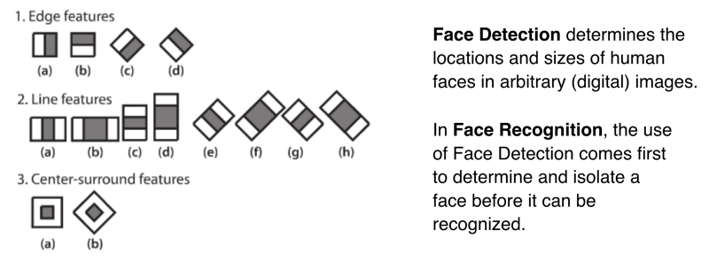

Slide 8
